Slide 1
Internal Controls and Managerial Accounting Topics 8 and 9
Presented by:
Dr. Walfyette Powell, CPA
Cohort starts at 9:30 AM MST (8:30 PST, 10:30 CST, 11:30 EST)
Please feel free to chat with me or others until the Cohort starts. Please us the conference call line to access the room’s sound to prevent feedback and background noise (See Notes). Once the Cohort starts, I will mute all your phones to control background noise and feedback from them.

Slide 2
Internal controls and Regulations
What are common financial statement errors?
What internal controls should be used to prevent accidental loss or intentional theft or fraud for a specific situation?
Why and how do companies manage earnings?
What is Sarbanes-Oxley (SOX), and how does it affect companies and their auditors?
What role does the Securities and Exchange Commission have in financial accounting?
Other organizations related to financial reporting

Slide 3

Common financial Statement Errors
Errors - Result when unintentional mistakes are made in recording transactions, posting transactions, summarizing accounts, and so forth. Errors are not intentional and when detected are immediately corrected. Errors can result from sloppy accounting, bad assumptions, misinformation, miscalculations, and other factors.
What are the causes?
Sloppy Accounting
Bad Assumptions
Misinformation
Miscalculations

Slide 4
Financial Statement Disagreements
Different people reach different conclusions on same fact set.
GAAP contains many areas of judgment on which reasonable people may differ
Different people can reach different conclusions because of different incentives

Slide 5

Financial Statement Fraud
Frauds - Result from intentional errors. Fraudulent financial reporting occurs when management chooses to intentionally manipulate the financial statements to serve their own purposes, such as meeting Wall Street’s earnings forecasts as was the case with WorldCom or the world famous case of Enron.

Slide 6
Purpose of Internal control
To provide accurate accounting records and financial statements containing reliable data for business decisions.
To safeguard assets and records. Most companies think of their assets as including their financial assets (such as cash or property), their employees, their confidential information, and their reputation and image.
To effectively and efficiently run their operations, without duplication of effort or waste.
To follow management policies.
To comply with the Foreign Corrupt Practices and Sarbanes-Oxley acts, which require companies to maintain proper record-keeping systems and controls.
Notes:
The first step you would probably do is write down the supplies you are ordering. It might be as simple as a yellow sheet of paper to a formal numbered purchase order (PO).
The next step would be to match the PO to the shipping document after counting the supplies/inventory delivered. This could be as simple as matching your yellow sheet of paper to the shipping document or matching the PO to the bill of lading to a formal receiving report. The larger and more sophisticated the company, the more sophisticated the reporting. The count might be done by you or it may be done by one or more employees in
You would then match these documents to the supplier’s invoice to make sure everything matches. If everything matches and you approve, cut the check. As a small business owner, you might do this or several employees may be involved in a larger company.
Let’s not forget about the supplies or inventory that was purchased. Is it valuable? Did you just throw it in the corner? What’s to keep someone from just walking off with it. What about your blank checks? Can anyone have access to the checks?

Slide 7
Elements of Internal control system
The control environment
Risk assessment
Control activities
Information and communication
Monitoring

Slide 8
Control Activities (procedures)
Control activities or control procedures fall into five categories:
Segregation of duties
Proper procedures for authorizations
Physical control over assets and records
Adequate documents and records
Independent checks on performance
Notes:
The first step you would probably do is write down the supplies you are ordering. It might be as simple as a yellow sheet of paper to a formal numbered purchase order (PO).
The next step would be to match the PO to the shipping document after counting the supplies/inventory delivered. This could be as simple as matching your yellow sheet of paper to the shipping document or matching the PO to the bill of lading to a formal receiving report. The larger and more sophisticated the company, the more sophisticated the reporting. The count might be done by you or it may be done by one or more employees in
You would then match these documents to the supplier’s invoice to make sure everything matches. If everything matches and you approve, cut the check. As a small business owner, you might do this or several employees may be involved in a larger company.
Let’s not forget about the supplies or inventory that was purchased. Is it valuable? Did you just throw it in the corner? What’s to keep someone from just walking off with it. What about your blank checks? Can anyone have access to the checks?

Slide 9
Types of internal controls?
Preventative Controls “prevent” problems from occurring
Segregation of Duties (Also allows detection)
Proper procedures for authorization
Physical access controls
Detective Controls catch problems that are occurring before the problems become large.
Adequate documents and records
Internal Audits
Notes:
Think about what controls you might put in place for each of these areas.

Slide 10
Assessment Question
Which two examples represent ﬁnancial statement errors?
Choose 2 answers
An accounting employee overpays a supplier and receives a portion of the excess as a kickback.
The accounting department miscalculates the payroll tax due at year-end, resulting in an inaccurate liability
The outside auditor disagrees with the amount reported as an allowance for uncollectible accounts receivable.
The accountant unintentionally records amounts as revenue that were prepaid by customers but not yet earned

Slide 11
Assessment Question
Which internal control is intended to ensure that a company does not mistakenly pay a supplier for an invoice that includes more items than were actually received?
The purchasing department authorizes the order of all items before they occur.
The company requires two signatures on each check in order for a payment to be sent.
The inventory department counts and inspects items as received and forwards the receiving record to accounts payable.
The accounts payable department utilizes prenumbered checks in the payment of supplier invoices.

Slide 12
Reasons for earnings management
Some of the reasons that managers may manipulate reported earnings are as follows:
Meet internal targets
Meet external expectations
Income smoothing
Window dressing for an IPO or a loan

Slide 13
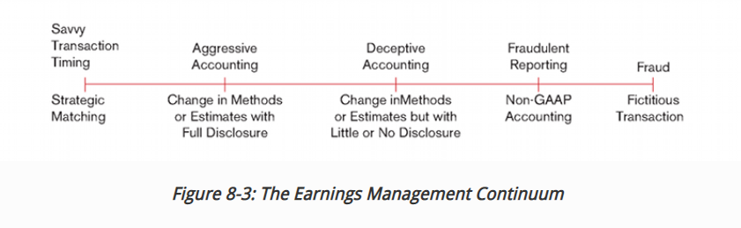
Methods of earnings management
There is no fixed ethical guidelines as to what is ethical what isn’t, other than fraud never is and is usually illegal

Slide 14
Sarbanes-Oxley (SOX)
SOX – most comprehensive legislation affecting the accuracy of financial reports since the initial SEC acts in 1933 and 1934.
PCAOB – created through SOX to oversee the accounting and auditing profession
Registers all public accounting firms that provide audits for public companies.
Establishes standards relating to the preparation of audit reports for public companies.
Conducts inspections (reviews) of accounting firms.
Conducts investigations and disciplinary proceedings and impose appropriate sanctions on public accounting firms whose performance is inadequate.
Enforce compliance with SOX

Slide 15
Sarbanes-Oxley (SOX)
Constraints on Auditors
Prohibited from providing several nonaudit services such as management functions, legal services, and investment advisors
Audit partners on engagements must be rotated off the audit every five years
Auditors report to and be retained by the audit committee rather than the CFO or other members of the company's management.
Notes:
Auditors may not offer to their clients: bookkeeping or other services related to accounting records or financial statements; financial information systems design and implementation; appraisal or valuation services; actuarial services; internal audit outsourcing services; management functions or human resources; broker or dealer, investment adviser or investment banking services; legal services and expert services unrelated to the audit; any other service that the Board determines is impermissible.

Slide 16
Sarbanes-Oxley (SOX)
Constraints on Management
The CEO and CFO must certify to the appropriateness of the financials and disclosures.
Management must report on the effectiveness of the internal controls in each annual report.
Loans to executive officers and directors are prohibited.
Management must support a much stronger board and audit committee in each public company.
Notes:
The audit committee is a subset of the board of directors and must consist only of individuals who are not part of the management team of the company,

Slide 17
Role of External Auditors
Independent accountants (usually CPAs) that review a firm’s controls and transactions.
Provide reasonable assurance that the financial statements are prepared according to GAAP and fairly present the financial results in all material aspects
Provide reasonable assurance that the firm’s controls are effective (public companies)

Slide 18
The role of Internal auditors
Internal group of experts in controls, accounting, and operations.
Monitor operating results and financial records.
Evaluate internal controls.
Assist with increasing efficiency and effectiveness of operations.
Detect fraud.
Audit manager reports directly to the president and audit committee of the BOD.
Notes:
Internal auditors preserve the integrity in the reporting process. They also provide the company with “perception of detection.”

Slide 19
Securities and exchange commission (sEC)
Agency of the federal government.
Purpose is to assist investors in public companies by regulating stock and bond markets and by requiring certain disclosures.
Requires companies who issue new debt to submit a registration statement for approval.
Adds credibility to financial statements
Require independent audits
Review financial statements
Sanction firms that violate standards
Suspend trading and delist securities.

Slide 20
Other Critical Organizations
AICPA
The American Institute of Certified Public Accountants (AICPA) - professional organization of certified public accountants (CPAs) in the United States.
CPA - someone who has taken a minimum number of college-level accounting classes, has passed the CPA exam, and has met other requirements set by his or her state.
CPA firm - a company that provides freelance business advice, particularly in connection with accounting issues and executes the vast majority of external audits in the US.
The AICPA
sets ethical standards for CPAs,
provides continuing education for them,
writes and grades the CPA exam,
lobbies for legislation favored by CPAs, and provides other support to CPAs.

Slide 21
Other critical Organizations
IASB
The International Accounting Standards Board (IASB) was formed in 1973 to develop a common set of worldwide accounting standards. IASB standards are increasingly accepted worldwide, but FASB rules are still the standard in the United States. The standard they set are call International Financial Reporting Standards (IFRS).

Slide 22
Other critical organization
FASB Financial Accountings Standards Board (FASB).
A private, non-profit body established and supported by the joint efforts of the U.S. business community, financial analysts, and practicing accountants.
Sets Generally Accepted Accounting Standards (GAAP) in the US but has no legal power to enforce them.
The SEC has the legal authority to set GAAP but has delegate that responsibility to the FASB.

Slide 23
Other critical organization
Internal Revenue Service (IRS)
processes tax returns and collections income taxes in the US.
interprets the Internal Revenue Code passed by Congress and establishes rules to define exactly when income should be taxed.
has no role in setting financial accounting rules; and a company's financial statements are not used in determining how much tax the company must pay.

Slide 24

Internal Control Questions?

Slide 25
Management Accounting and Cost concepts
Describe the purpose of management accounting
Differentiate between management and financial accounting
Describe the difference between a manufacturing environment and a service environment.
Define common terms and concepts used in management accounting.
Distinguish between product costs and period costs.

Slide 26
Describe the purpose of management accounting
Managerial accounting processes economic information to be used by management in making decisions. Financial accounting involves the preparation of general-purpose financial statements used by various users in making informed decisions.
http://www.accountingverse.com/managerial-accounting/introduction/managerial-vs-financial-accounting.html

Slide 27
management VS financial accounting
Table 9.1
Differences Between Management Accounting and Financial Accounting
Table 9.1 | Management Accounting | Financial Accounting
Source | Evolves from the best practices of companies working to be competitive | Is legislated and governed by regulatory agencies and professional institutions
Purpose | Exists to serve the competitive needs of organizations working to uniquely serve specific customers in specific markets | Exists to serve the need for organizations to periodically report results to outside investors and lenders in a consistent and comparative manner
Outcome | Results in both financial and nonfinancialdata that are proprietary (ie., guarded from becoming available to competitors and the general public) | Results in only financial data that are public and reported in a consistent manner to investors and creditors

Slide 28
Managerial accounting terminology Define common terms and concepts used in management accounting.
Fixed cost – doesn’t change in total as units sold changes, but per unit costs change inversely with units sold.
Variable costs – changes proportionately with units sold in total, but is fixed per unit.
Differential costs - A future cost that can be changed by a decision made now and therefore is relevant to making the decision.
Sunk cost – A past cost that cannot be changed by any decision made now and therefore is irrelevant to making decisions about the future.
Out-of-pocket costs – Cost that involves the outlay of cash or the use of some other asset (such as equipment).
Opportunity cost – The benefits not received because of actions not taken.

Slide 29
Fixed/Variable Cost Example
Stewart Manufacturing produces and sells die cast race cars. VC for each die cast car is $3 and total FC are $300,000
VC per unit Total VC FC per unit Total FC
Stewart sells 1,000 units 3.00 3,000 300 300,000
Stewart sells 2,000 units 3.00 6,000 150 300,000
Stewart sells 5,000 units 3.00 15,000 60 300,000
As sales increase:
Total Variable costs increase, Per Unit Variable costs remains the same
Total Fixed Costs remains the same, Per Unit Fixed Costs decrease

Slide 30
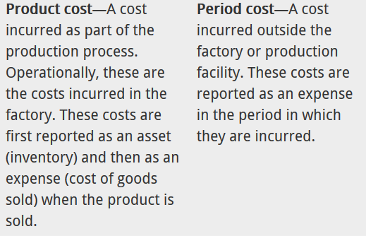
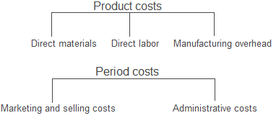
product costs vs period costs

Slide 31
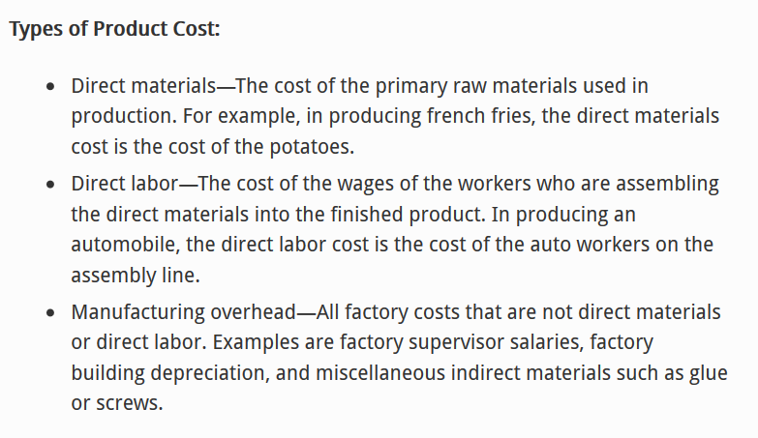
product costs vs period costs (cont.)

Slide 32
product costs vs period costs (cont.)
Period Costs
Costs not directly associated with the product.
President’s salary
Selling Costs
Office costs
Sales salaries
Advertising
Legal and accounting fees
Dues and subscriptions
Office utility costs
Supplies

Slide 33
Need for Ethics in Managerial Accounting
The chief accountant in most organizations is the controller.
Those persons involved with creating management accounting information will occasionally confront ethical issues inside the organization.
The Institute of Management Accountants (IMA) provides guidance on ethical professional practice to help professionals involved in management accounting processes.

Slide 34
IMA Code of Ethics
Members are ethically required to
Be competent in their profession
Not disclose confidential information
Act with both actual and apparent integrity in all situations
Maintain objectivity when communicating information to decision maker

Slide 35
COST CONCEPT QUESTIONS?

